Slide 1
Stock Price Prediction
Using Deep Neural Networks
A project for the Deep Neural Networks Course of DSIT Master’s Program
Supervisors
Dr. Haris Papageorgiou
Athanasia Kolovou
Team Members
Karampasis Ilias
Polydoros Athanasios
Rempoulaki Anastasia

Slide 2

Contents
Introduction
Task definition
Dataset
Pre-processing
Models
Experiments
Conclusions
Future work

Slide 3
Introduction

Slide 4
Stocks 101
The closing price is the last price at which a stock traded during the regular trading day
It’s used as reference when looking past prices of a stock
Stock price depends on several things
Enterprise
News
Tweets
Company decisions

Slide 5
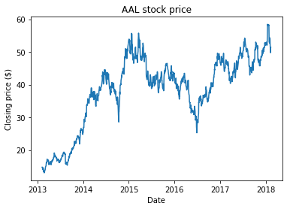
Closing price of AAL stock

Slide 6
Task Definition

Slide 7
Task definition
Given the closing price of previous N days, predict the closing price of N+1 day.
But is this really possible?
Most of papers/articles conclude that predicting stock price using just previous prices performs poorly on unseen data

Slide 8
Our Goal
The goal of the project is to train, test and compare 3 different models in order to prove or refute this statement

Slide 9
Dataset

Slide 10
Dataset
Our dataset consists of historical stock prices for all companies found on the S&P 500 Index
between years 2013 - 2018.
500 biggest companies in United States stock market .
Utilized stock name and closing price.
Other unused columns (open price, daily highest price, daily lowest price, date and volume).
0 null values for closing price.
The closing price ranges from $1.59 to $2049 (mean ~$83).
1200 rows per stock.
Notes:
Ογκος συναλλαγων

Slide 11
Dataset splitting
Same stock for training and testing (AAL).
70% training set.
10% validation set.
20% testing set.
Test on unknown stock.
AAL stock as training set.
GOOGL stock as testing set.

Slide 12
Data Pre-processing

Slide 13
Preprocessing
Each row of dataset contain the closing price in dollars
Convert prices to the range [0, 1]
Take a fixed-size sliding window over the normalized closing prices

Slide 14
Price normalization
Apply Min-Max normalization over the train set.
Necessary in cases of datasets with large values.
Normalizes the values according to the min and max values of a feature (our case: closing price).
Neural networks perform best with inputs within [0, 1].

Slide 15
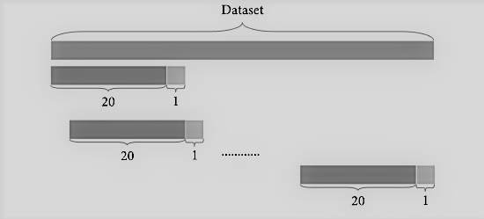
Data slicing
Taking a sliding window over the normalized closing prices.
Use the first values 20 values (0 - 19) as input and the 21st as output
Slide the window by one and use this as input (1 - 20), etc.
Notes:
Ενα παραθυρο σταθερου μεγεθους για να χωρισουμε το dataset σε input και output

Slide 16
Models

Slide 17
Models
We will train and experiment with 3 models
Feedforward neural network
LSTM
RLSTM

Slide 18
Feedforward neural network
Dense layers 2
64 units
RELU
A single output layer

Slide 19
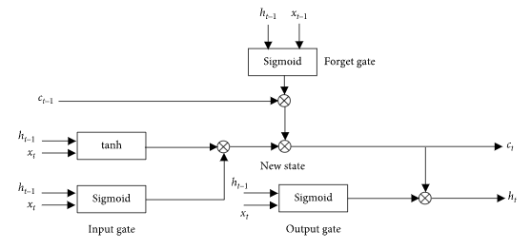
LSTM
An extension of RNNs (recurrent neural network).
A solution to the vanishing gradient problem.
LSTM are capable of learning long-term dependencies by extending their memory cells and utilizing a gating mechanism to control information flow.
The memory cell consists
of three gates – input,
forget and output gate.

Slide 20
LSTM
Training process details:
LSTM layer:
4 hidden layers
Adam optimizer
50 units each layer
Mean Squared Error for loss
Dropout Layer with rate 0.2.
Dense layer with 1 neuron as output size.

Slide 21
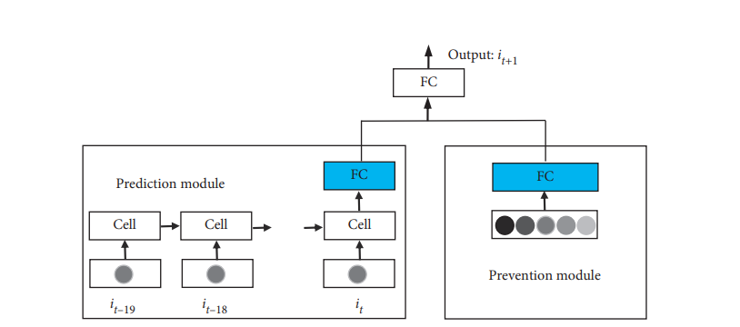
RLSTM
Notes:
Proposed by Hongying Zheng, Zhiqiang Zhou and Jianyong Chen (May 2021)
Better generalization ability, over-fitting mitigation
Prediction module: composed of a LSTM and a fully connected network layer. Input: the prices of the stock we need to predict.
Prevention module: a fully connected network layer. Input: random data which are extracted from the uniform distribution within the range between the highest and the lowest prices of the target stock.
Above the two modules, there is the third fully connected layer. Inputs are just the outputs of the two modules. Prediction can be obtained after computation of the third fully connected layer.
Not entirely a breakthrough. Similar to the ModAugNet-c, but faster and less complex.

Slide 22
RLSTM
Training process details:
Mean square loss
Adam optimizer
Early stopping against overfitting
Learning rate: 0.00001
Hidden units for LSTM: 32
Batch size: 32
Notes:
Prediction Module FC layer: 4 nodes
Prevention Module FC layer: 2 nodes
Output Module FC layers: 2 nodes => 1 node (predicted price)

Slide 23
Experiments

Slide 24
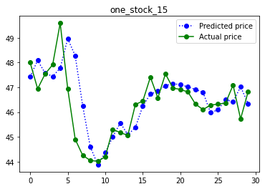
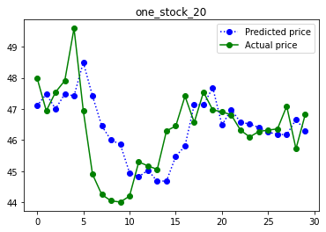
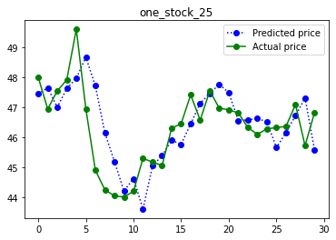
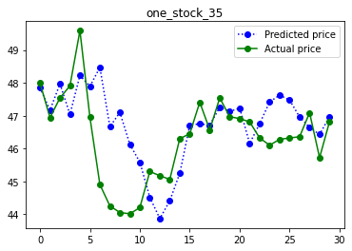
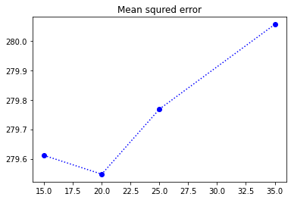
Window size
Train and test using different window size.

Slide 25
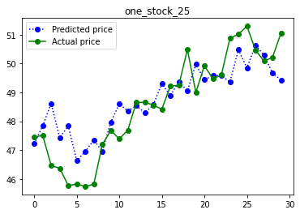
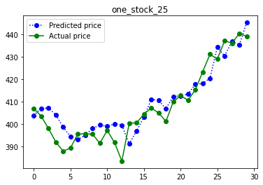
Feedforward NN
Trained/test same stock
Split dataset
MSE 282.4551
Test on unknown stock
Test dataset GOOGL stock
MSE 2327.6162

Slide 26
Error over different part of data
 | MSE | MAE | MAPE
Seen data | 563.79144 | 22.613684 | 97.4674
Unseen data | 2210.255 | 46.882046 | 98.04332
Other stock | 166421 | 407.6193 | 99.98

Slide 27
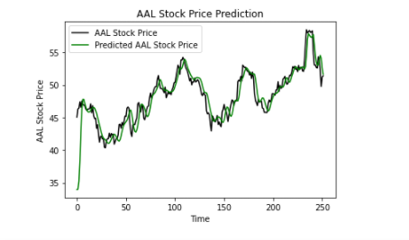
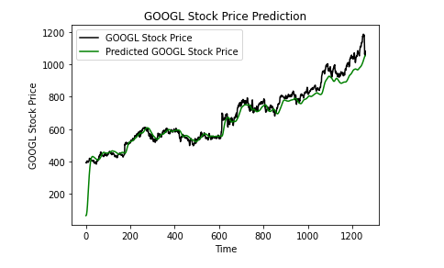
LSTM
Trained/test same stock
Split dataset
MSE 3.6569757
MAE 1.1791536
MAPE 2.481861
Test on unknown stock
Test dataset GOOGL stock
MSE 418.25244
MAE 14.210677
MAPE 2.38179
Notes:
Ακολουθουν την γενικη ταση των τιμων και τα ερρορ ειναι παρομοια

Slide 28
RLSTM - Window size comparison
AAL test data
GOOGL test data
Window Size | MSE | MAPE | MAE
10 | 1.4809374 | 1.9340013 | 0.9297623
20 | 1.0105144 | 1.5399454 | 0.7394376
30 | 1.0925528 | 1.5943699 | 0.7719636
50 | 1.0195653 | 1.5656259 | 0.763823
Window Size | MSE | MAPE | MAE
10 | 250.70139 | 1.162531 | 11.399309
20 | 152.65657 | 0.8883535 | 8.70735
30 | 185.10663 | 0.9753567 | 9.629498
50 | 190.9459 | 0.9991968 | 9.976211

Slide 29
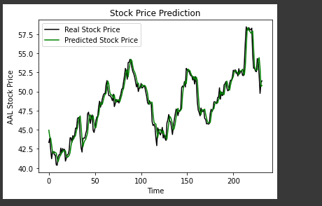
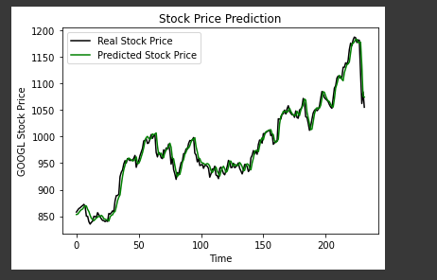
RLSTM - Graphs
Window size 20
AAL test data:
GOOGL test data:

Slide 30
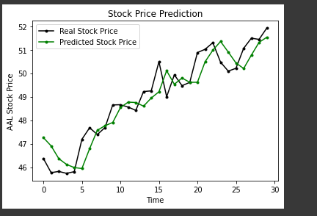
RLSTM - Graphs
But are the results really so good???
Let’s zoom in and take a glimpse in a tighter time frame:

Slide 31
Conclusions

Slide 32
We found out that…
All three models managed to predict the general trends
All three models tend to slightly mispredict the exact value for the next day
Strong indication that neural networks cannot accurately predict the price of a stock just by looking at its previous prices.
Worst model is the simple NN.
RLSTM outperformed LSTM, both with “familiar” test data and with unknown stock test data

Slide 33
Future work

Slide 34
There is always room for improvement
Extend RLSTM with more LSTM layers in prediction module.
Experiment with the number of neurons in the FC layers of the RLSTM to find the optimals for our training set.
Provide more data about the market and include sentiment analysis on articles and tweets.
Provide as input to the model the stock sector alongside some correlation between similar stocks.

Slide 35
Thanks!
ANY QUESTIONS?

